Slide 1
mgmt-571 project report
Credit default forecast

Slide 2
Agenda
Objective
Data Transformations
Algorithms explored
Final Algorithm Chosen
Learnings and conclusion

Slide 3




A credit card default occurs when a borrower fails to make his/her credit bill payment and falls behind
OBJECTIVE:
Non-Defaulter
Historical Payment Status
Demographic Information
Classification Model
Defaulter
An accurate prediction of default probability can balance the risk and return for the lender
Lender can utilize default probability to alter certain aspects of the transaction before lending some sort of a loan, like charging higher rates of interest

Slide 4
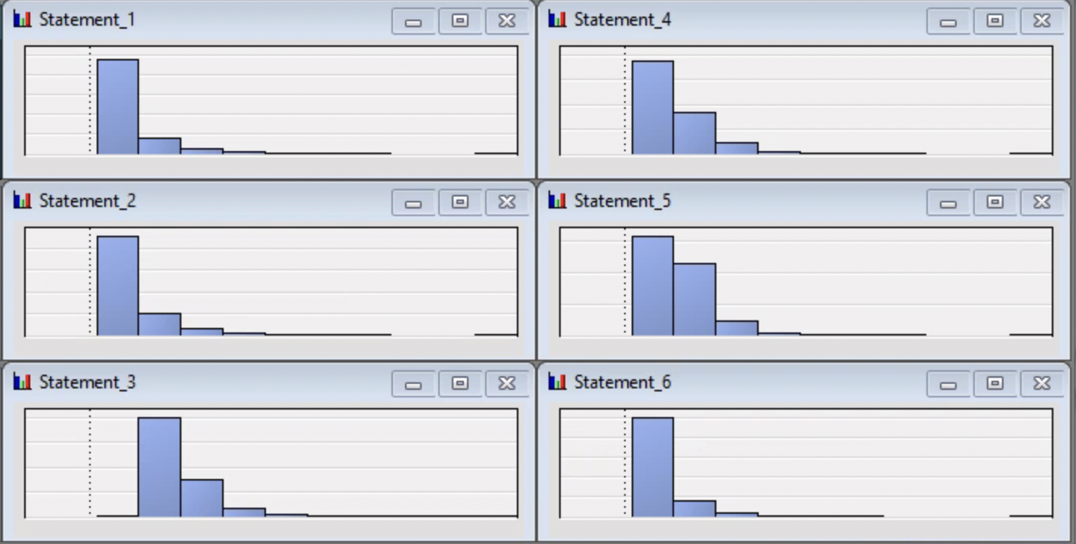
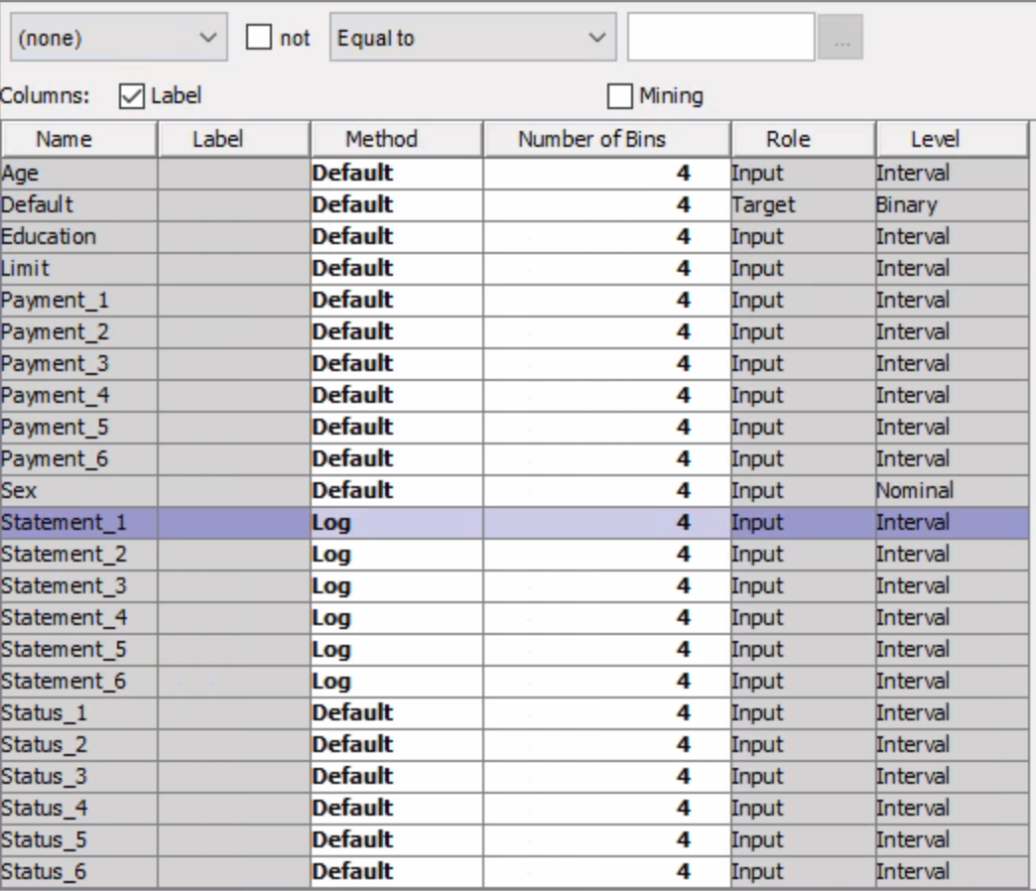
Due to the presence of skewed variables, we applied data transformations to normalize them
Transformations:
- On analyzing the data, we identified that the statement variables were skewed, and performed log transformations to normalize the variable.
- Furthermore, for the default selection, we identified the SAS EM’s selection as Best for
default methods in interval inputs and dummy indicators in class inputs performed best amongst all others.

Slide 5
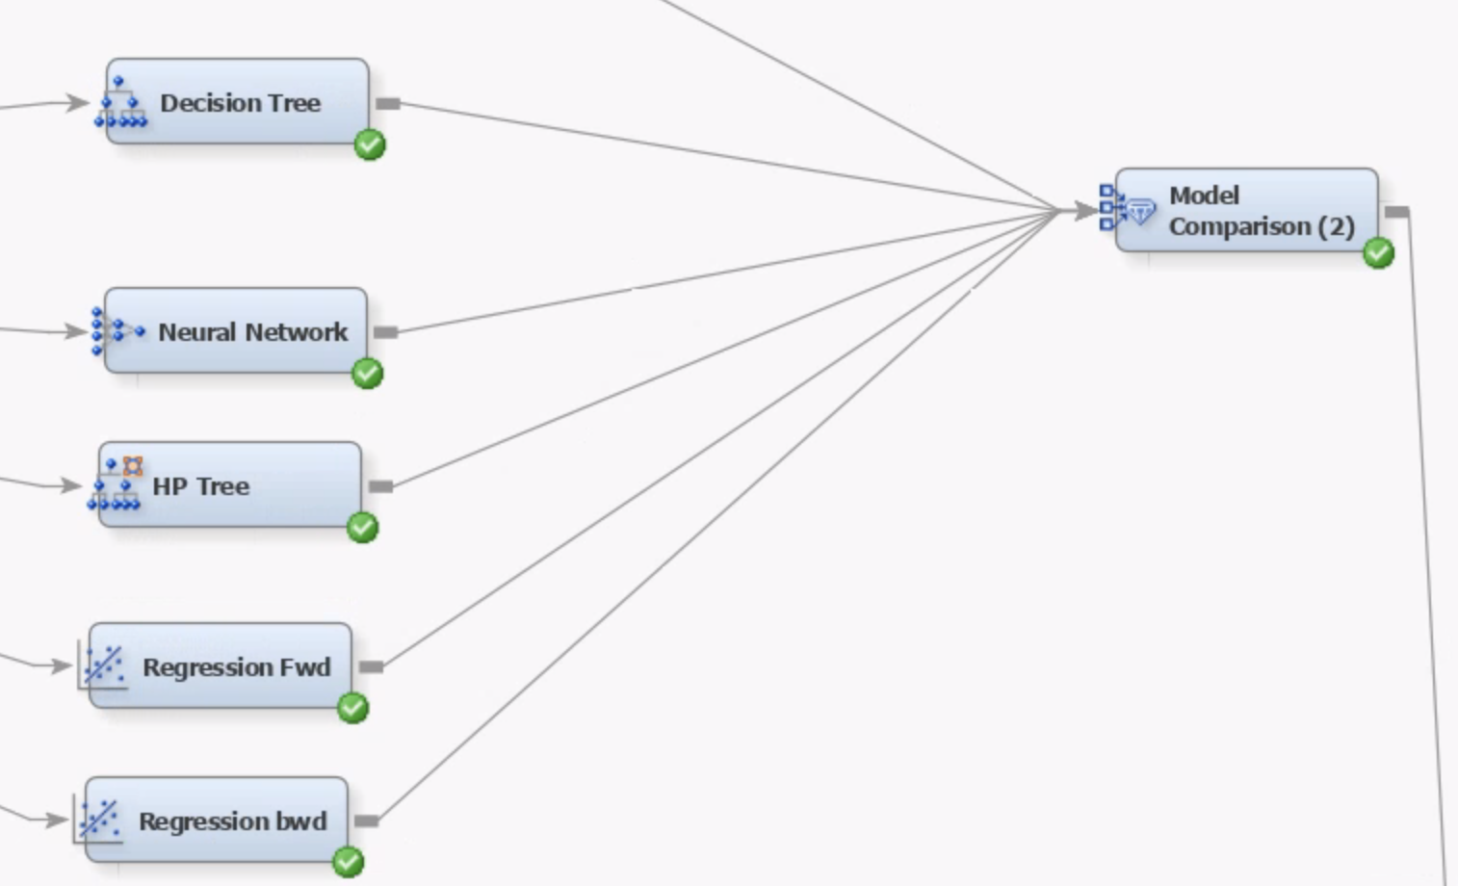
We explored models starting with Logistic Regression, Neural Networks, Decision Trees and Gradient boosting
Our initial plan was to compare individual models and use the best one based on Validation ROC; Below is a brief outline of the individual models we tested:
Logistic Regression: We ran two regression models, with Forward and Backward selection with 80 : 20 Train : Validation split; The ROC we obtained was decent with 71.6% for forward selection and. 70.2% for backward
Neural Network: With 14 hidden units, the neural network model achieved an ROC of 70.2%
Decision Tree and HP Tree: Both achieved ROCs of only about 66.5% and 66.4%.
Gradient boosting: We used gradient boosting methods and tuned the hyperparameters to check the impact on the ROC. Moreover, an ensemble of gradient boost yielded the best results.

Slide 6
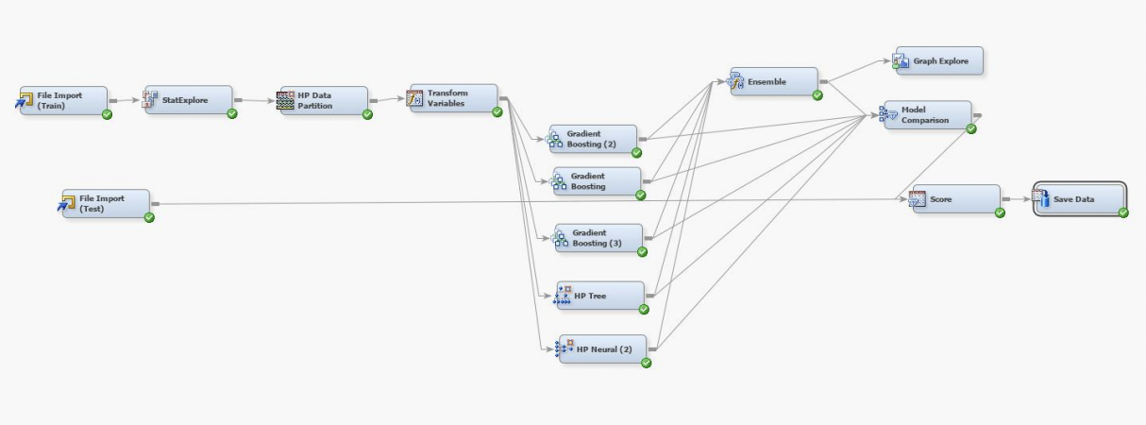
An Ensemble node with the best ROC - THE CHOSEN ONE
To finetune the accuracy of the prediction, we observed that tuning the following parameters in gradient boosting and performing an ensemble of all yielded greater ROC:
Maximum depth – 4,5,6
Maximum Reuse Variable – maximum 2 (we observed that increasing beyond 3 resulted in overfitting)
N iterations- 100,150,300; shrinkage- 0.1,0.03,0.05
Train proportion- 70,80,90ntboosting parameters for the 3 nodes used are as follows:

Slide 7

LEARNINGS
From this project, our learnings were as follows:
Gradient boosting node performed better once we were able to understand the workings and modifications required in the hyperparameters
Optimization in the tuning parameters to control overfitting
We understood the importance of data transformations and the impact of precise selection of the dependent variables in this classification problem.

Slide 8
Thank You

